Slide 1
MDS & Cluster Analysis Project
Andrew Lexvold & Maddie Moyer

Slide 2
Data Set
2010 County Health Data
Variables
Chlamydia Rate*
Teen Birth Rate*
% College Degrees
% High School Graduation
Goal: To understand what Counties were similar with respect to these variables
*Rate is per 100,000 residents

Slide 3
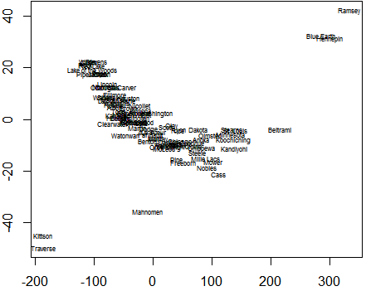
Classic Multidimensional Scaling (Dissimilarity Matrix)
Notes:
There appears to be 3-4 groups based on dissimilarity. (1: Kittson, Traverse, (Mahnomen – Option for solo group), 2: Ramsey, Blue Earth, Hennepin, 3: ALL ELSE)

Slide 4
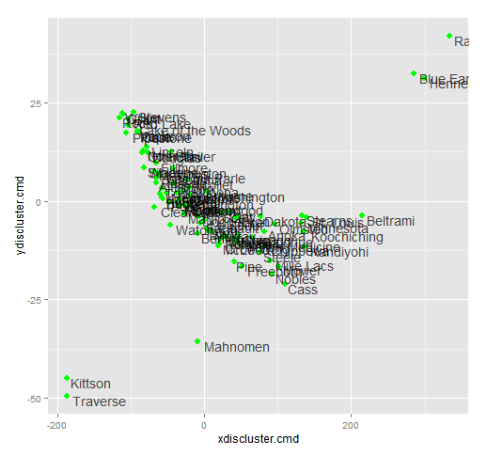
Additional Plot

Slide 5
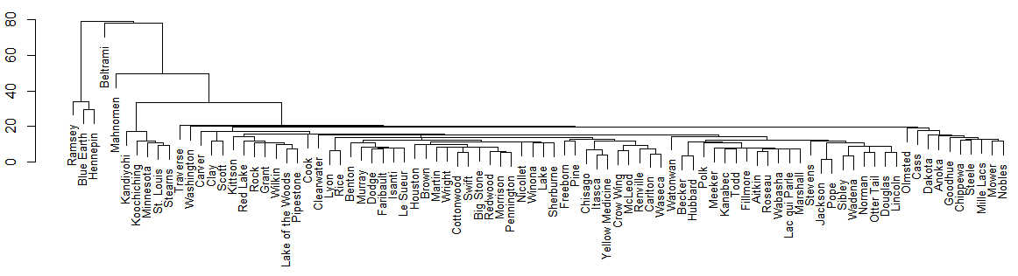
Single Cluster
Here you can see again there should be 4 clusters within the data set
1: Ramsey, Blue Earth, Hennepin
2: Mahnomen
3: Beltrami
4: All Else

Slide 6
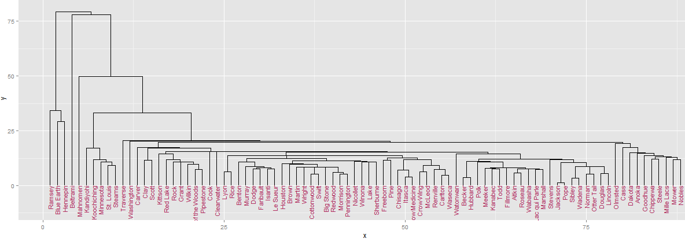
Single Cluster

Slide 7
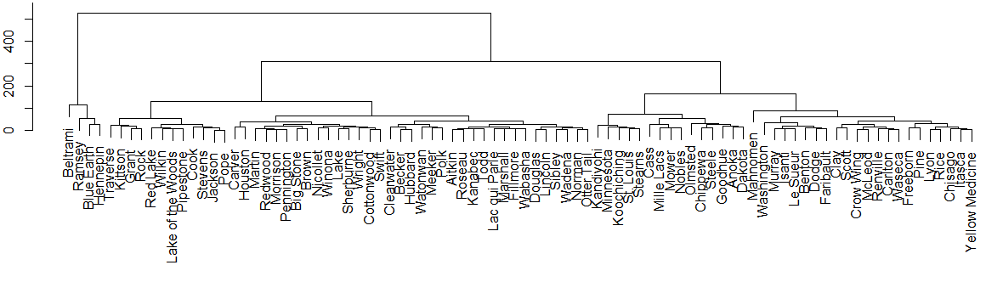
Complete Cluster
Here there should be 3 Clusters
1: Beltrami, Ramsey, Blue Earth, Hennepin
2: Traverse – Otter Tail
3: Kandiyohi – Yellow Medicine

Slide 8
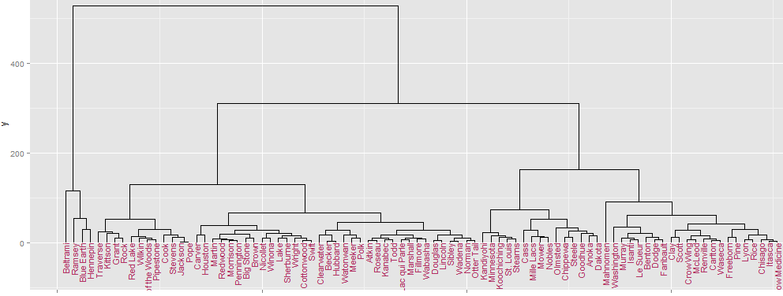
Complete Cluster

Slide 9
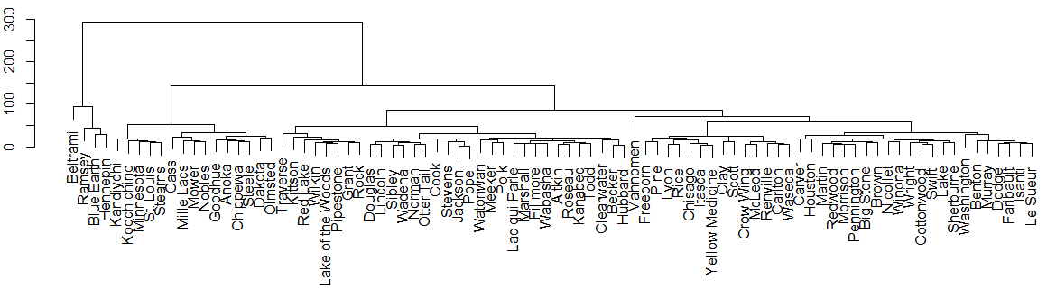
Average Cluster
Here there should be 3 Clusters for the Data Set
1: Beltrami, Ramsey, Blue Earth, Hennepin
2: Kandiyohi – Olmsted
3: Traverse – Le Sueur

Slide 10
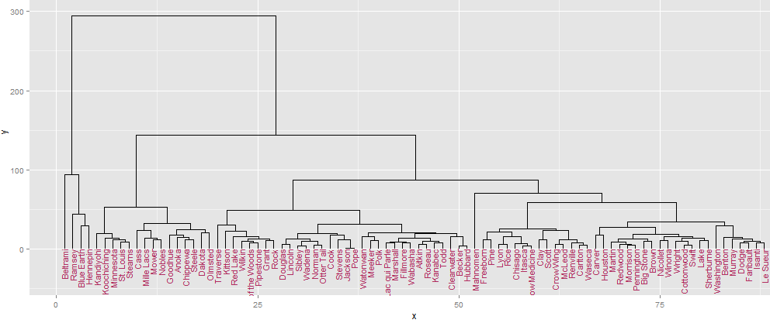
Average Cluster

Slide 11
Notes:
This is a Radial Graph from the Single Cluster analysis of the Data Set - You can see there should be 3 – 4 groups again.

Slide 12
Cut 1 2 3
Minnesota 1 1 1
Aitkin 1 1 2
Anoka 1 1 1
Becker 1 1 2
Beltrami 1 2 3
Benton 1 1 1
Big Stone 1 1 2
Blue Earth 1 2 3
Brown 1 1 2
Carlton 1 1 1
Carver 1 1 2
Cass 1 1 1
Chippewa 1 1 1
Chisago 1 1 1
Clay 1 1 1
Clearwater 1 1 2
Cook 1 1 2
Cottonwood 1 1 2
Crow Wing 1 1 1
Dakota 1 1 1
Dodge 1 1 1
Douglas 1 1 2
Faribault 1 1 1
Fillmore 1 1 2
Freeborn 1 1 1
Goodhue 1 1 1
Grant 1 1 2
Hennepin 1 2 3
Houston 1 1 2
Hubbard 1 1 2
Cut 1 2 3
Isanti 1 1 1
Itasca 1 1 1
Jackson 1 1 2
Kanabec 1 1 2
Kandiyohi 1 1 1
Kittson 1 1 2
Koochiching 1 1 1
Lac qui Parle 1 1 2
Lake 1 1 2
Lake of the Woods 1 1 2
Le Sueur 1 1 1
Lincoln 1 1 2
Lyon 1 1 1
McLeod 1 1 1
Mahnomen 1 1 1
Marshall 1 1 2
Martin 1 1 2
Meeker 1 1 2
Mille Lacs 1 1 1
Morrison 1 1 2
Mower 1 1 1
Murray 1 1 1
Nicollet 1 1 2
Nobles 1 1 1
Norman 1 1 2
Olmsted 1 1 1
Otter Tail 1 1 2
Pennington 1 1 2
Pine 1 1 1
Pipestone 1 1 2
Cut 1 2 3
Polk 1 1 2
Pope 1 1 2
Ramsey 1 2 3
Red Lake 1 1 2
Redwood 1 1 2
Renville 1 1 1
Rice 1 1 1
Rock 1 1 2
Roseau 1 1 2
St. Louis 1 1 1
Scott 1 1 1
Sherburne 1 1 2
Sibley 1 1 2
Stearns 1 1 1
Steele 1 1 1
Stevens 1 1 2
Swift 1 1 2
Todd 1 1 2
Traverse 1 1 2
Wabasha 1 1 2
Wadena 1 1 2
Waseca 1 1 1
Washington 1 1 1
Watonwan 1 1 2
Wilkin 1 1 2
Winona 1 1 2
Wright 1 1 2
Yellow Medicine 1 1 1
Notes:
Able to see exactly what counties go into what groups based on 3 clusters.

Slide 13
Final Conclusion
3 Clusters of Counties
Beltrami, Blue Earth, Hennepin, Ramsey
Aitkin, Becker, Big Stone, Carver, Clearwater, Cook, Cottonwood, Douglas, Fillmore, Grant, Houston, Hubbard, Jackson, Kanabec, Kittson, Lac qui Parle, Lake, Lake of the Woods, Lincoln, Marshall, Martin, Meeker, Morrison, Nicollet, Norman, Otter Tail, Pennington, Pipestone, Polk, Pope, Red Lake, Redwood, Rock, Roseau, Sherburne, Sibley, Stevens, Swift, Todd, Traverse, Wabasha, Wadena, Watonwan, Wilkin, Winona, Wright
Anoka, Benton, Carlton, Cass, Chippewa, Chisago, Clay, Crow Wing, Dakota, Dodge, Faribault, Freeborn, Goodhue, Isanti, Itasca, Kandiyohi, Koochiching, Le Sueur, Lyon, McLeod, Mahnomen, Mille Lacs, Mower, Murray, Nobles, Olmsted, Pine, Renville, Rice, St. Louis, Scott, Stearns, Steele, Waseca, Washington, Yellow Medicine

